Slide 1
CF969 - Big Data for Computational Finance Labs – 1. Python
Panagiotis Kanellopoulos

Slide 2
Python
Python is the primary programming language of this module.
It has with time become one of the two main languages for data science / data analysis / statistics.
(The other one is R.)
Python is:
A complete programming language;
One of the easiest to learn;
Imperative, but with features to support some object-oriented and functional programming;
Not the fastest in execution,
But compatible/extensible with C;
A huge number of libraries suitable for data-science-related topics,
E.g., Numpy, Scipy, matplotlib, Pandas, TensorFlow, Keras.

Slide 3
IPython and Jupyter
IPython stands for Interactive Python:
It is a powerful command line based shell and various other tools for working with Python.
Jupyter Notebook is built on top of Ipython:
It is a browser-based tool with which one creates documents (notebooks) that contain a mix of Python code, output, text, and graphics.
Useful for documenting and reporting on experiments, and explaining/discussing accompanying code.
Allows for on-line execution of code inside the notebook.
It is our primary tool that we will use to execute Python code in the labs.
Example:
https://github.com/rhiever/Data-Analysis-and-Machine-Learning-Projects/blob/master/example-data-science-notebook/Example%20Machine%20Learning%20Notebook.ipynb

Slide 4
Some Packages: Numpy
Numpy is a fundamental and extremely popular Python package.
It provides tools for vector- and matrix-operations.
Very fast execution times.
Almost every other library uses Numpy underneath.
We will use it extensively too.

Slide 5
Some Packages: Scipy
Scipy is a package for general scientific computing purposes.
Provides tools for:
Numerical computing;
Optimisation;
Linear algebra;
Statistics;
Clustering.
As you guessed: Built on top of Numpy.

Slide 6

Some Packages: TensorFlow
TensorFlow is a Python library providing dataflow programming functionality.
It provides extensive tools for deep learning and neural network applications.
Has some interesting special features:
Symbolic math library
(e.g. implements automatic symbolic differentiation).
Lazy evaluation in a dedicated engine.
Works with tensors as its elementary data objects.

Slide 7
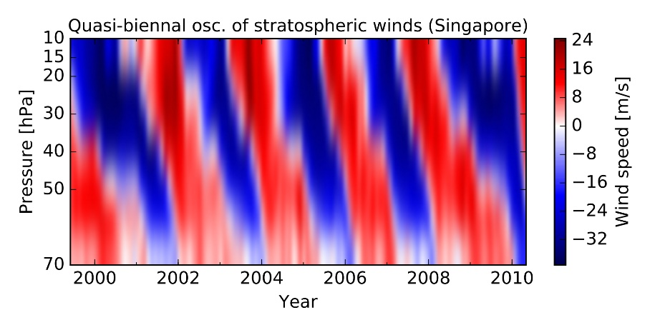
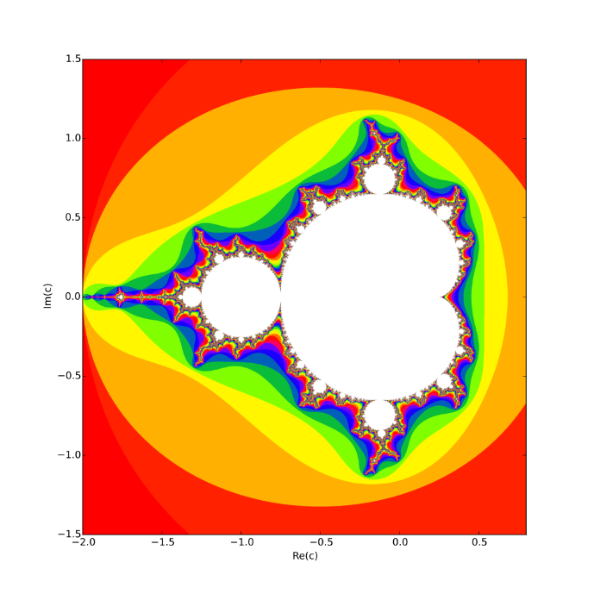
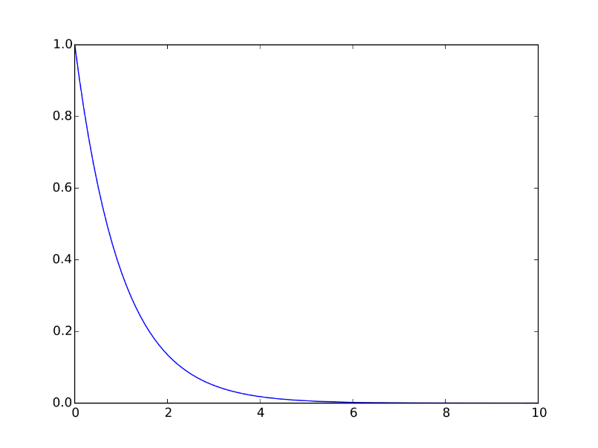
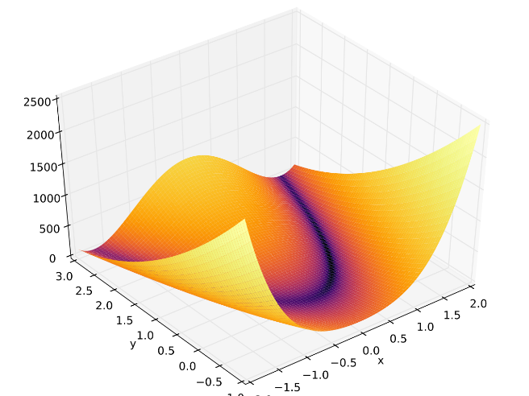
Some Packages: Matplotlib
Matplotlib is a Python package for data visualisation.
In particular: for producing plots.
Some examples (from Wikipedia):

Slide 8

Python resources
Check CF969 moodle page:
Python for beginners
The hitchhiker’s guide to Python
Python 3.10.2. documentation

Slide 9
Task for Lab 1:
You will work through a Crash Course on Python for Scientists.
This course can be found on this module’s Moodle page.
The course is originally written by Rick Muller, for Python 2 and was adapted by Bart de Keijzer and myself in order to make it compatible with Python 3.
(The original version of the tutorial is found on: http://nbviewer.jupyter.org/gist/rpmuller/5920182.)
Try to work your way through all of Section I.
If time allows, try to work on the Numpy and Scipy basics in Section II.
Understanding the example-subsections in Section II is less important.
Rather, skip these examples and proceed to Section III.
This will be:
easy if you have prior programming experience;
hard if you have never programmed before.
In the latter case: please spend more time on learning Python than just this lab.

Slide 10
Setting Up for Lab 1
Start Jupyter Notebook (in the same way would start any program that has been set up in the lab PC)
There is a more complex approach :
Open a Command Prompt
Start Jupyter Notebook by running “c:\Python3\Scripts\jupyter-notebook” from the command line
Create a new Notebook-file using the button on the top-right
Check the moodle page (Unit 1)

